Slide 1

Chinese K12 Education WeChat Article
Search Engine
CS410 Final Project
Gelei Chen
geleic2@Illinois.edu

Slide 2
Contents
Live Demo
Installation
Usage Instruction

Slide 3
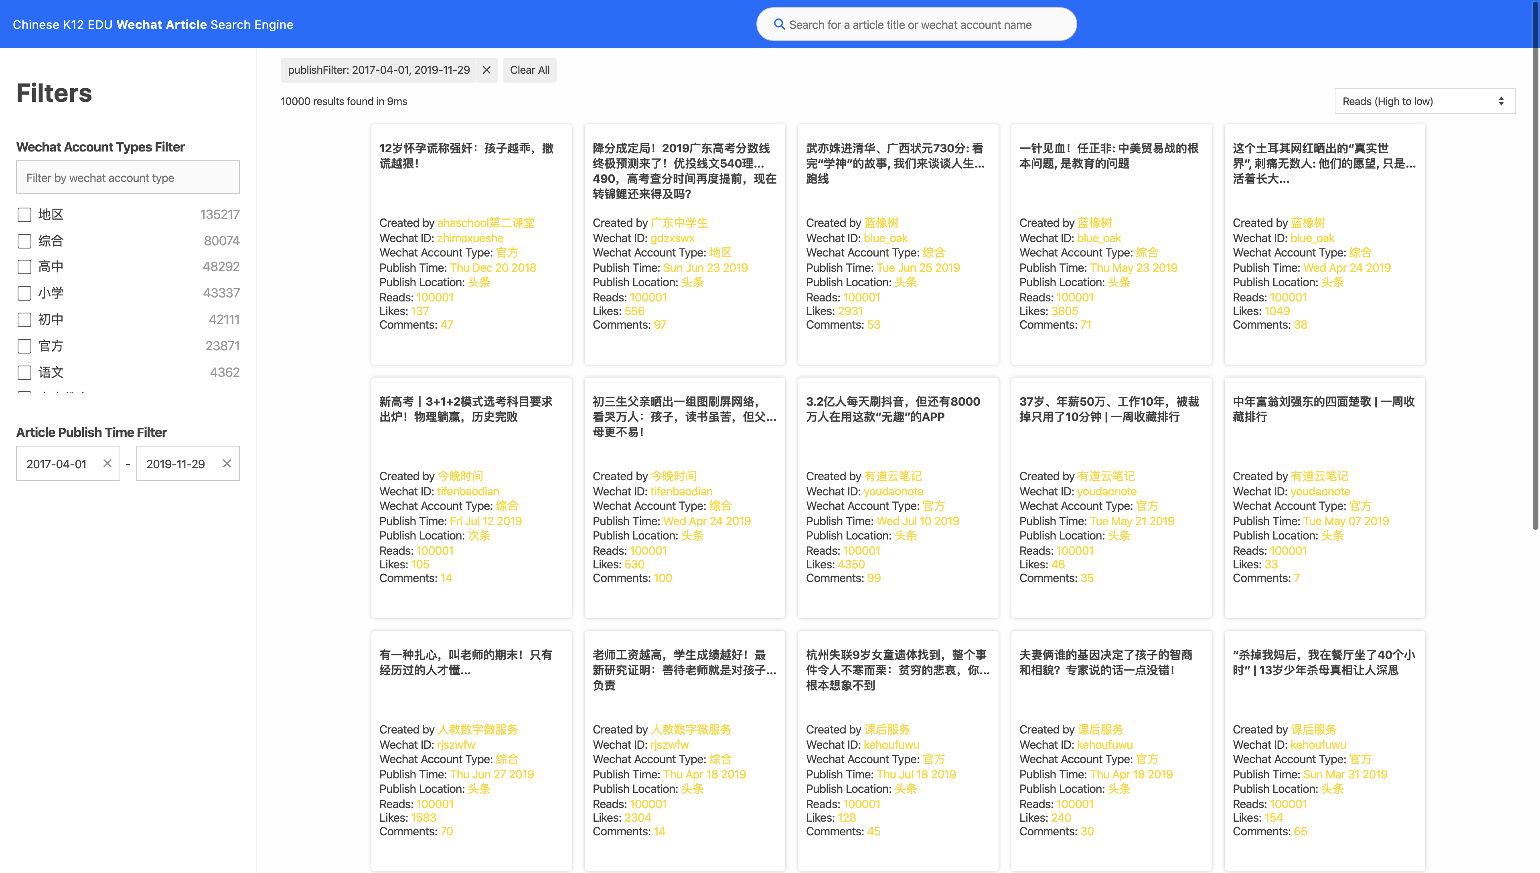


1.Live Demo
http://3.14.12.231:8002/
7. Search by the keyword
6. Filters/Clear all filters
1.Filter by WeChat account type
5. Engine statistics
4. Sort by Reads/Publish time
2. Filter by article publish time
3. The searched/filtered/ranked results

Slide 4
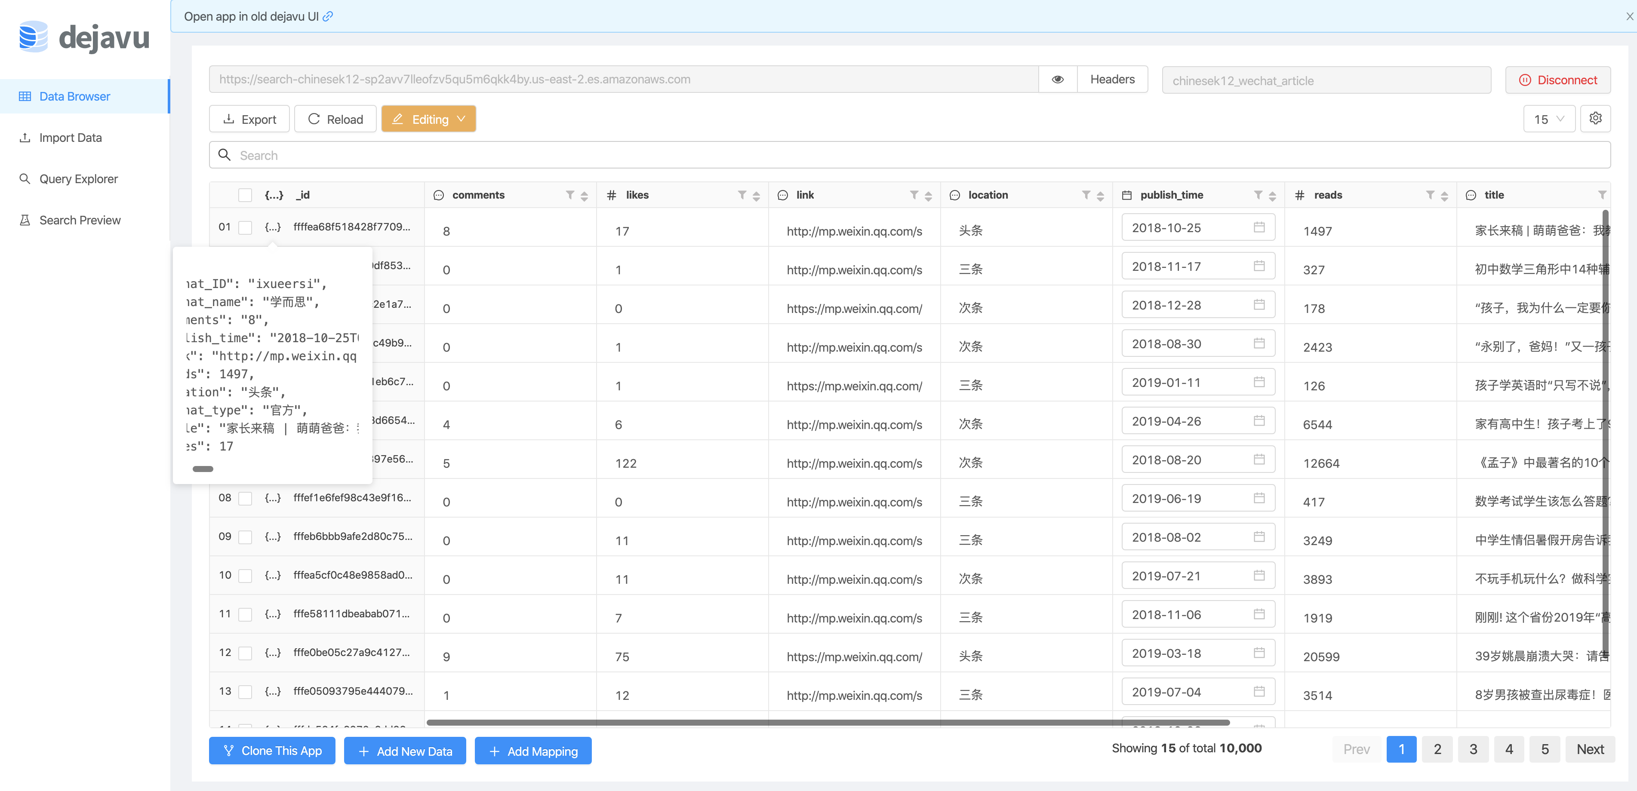
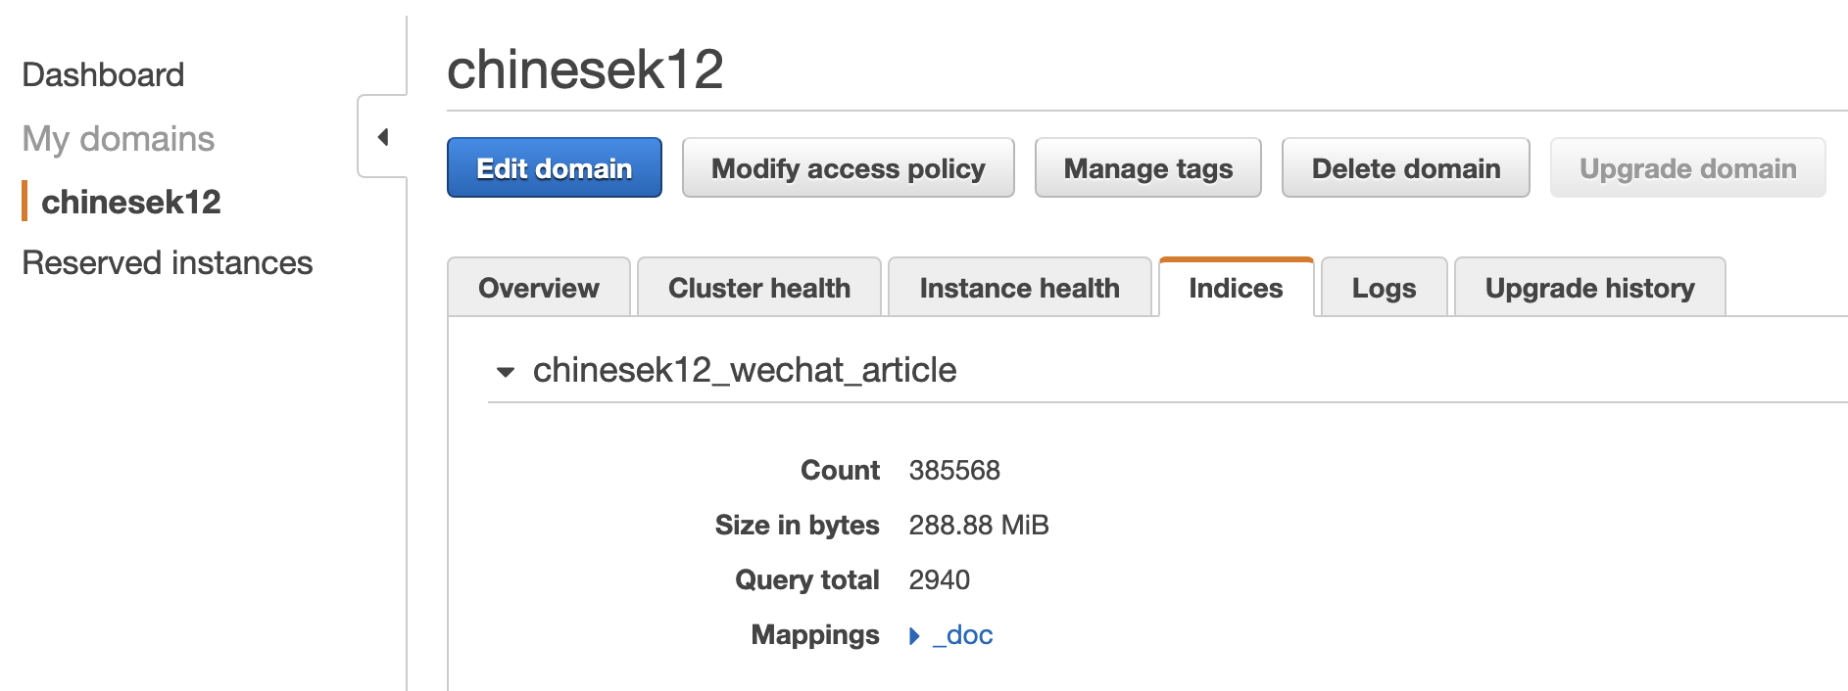
1.Live Demo
http://3.14.12.231:8002/
385568

Slide 5
1.Live Demo
http://3.14.12.231:8002/
385568

Slide 6
2.Installation
Server-side: Setup AWS Elasticsearch service & Write data into it
https://aws.amazon.com/elasticsearch-service/

Slide 7
2.Installation
Client-side: Setup AWS EC2 & Install dependence & Host the application

Slide 8
3. Usage Instruction

Slide 9
Thank you

